Slide 1
WFME accreditation of MAB 2021-2022

Slide 2
Hungarian Accreditation Committee (MAB)
Established by an act of parliament in the first Higher Education Act in 1993
One of the first higher education QA agencies in Europe
Responsible for the QA recognition for all HEIs (64) in Hungary
Relationships with a range of national and international organisations

Slide 3
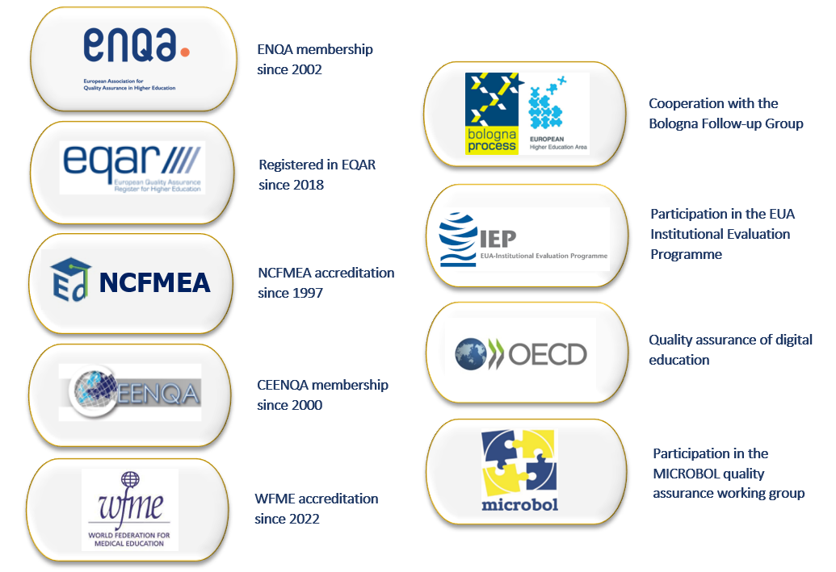
International relationships of MAB

Slide 4
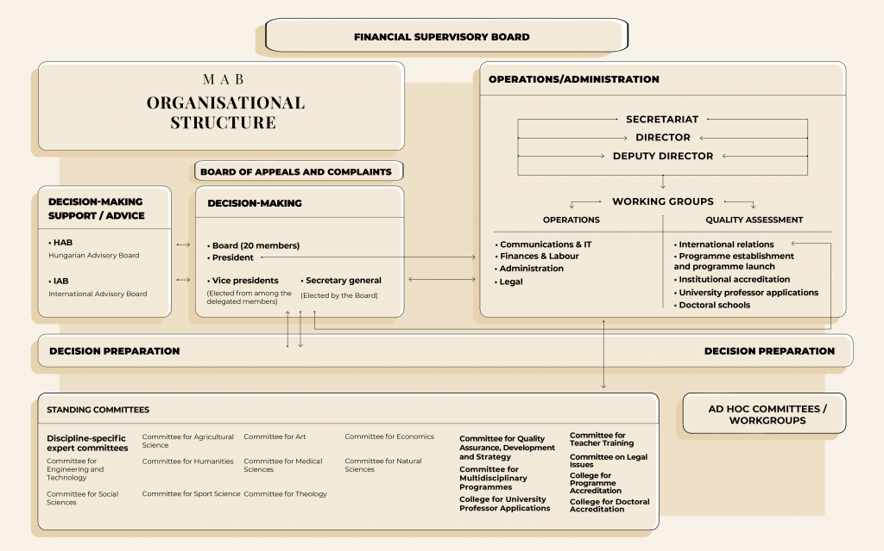
Organisational structure of MAB

Slide 5
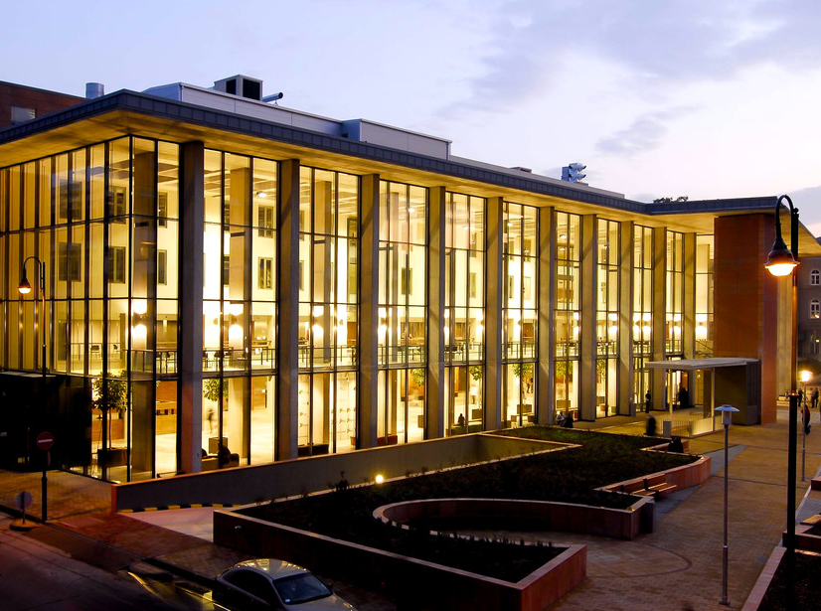
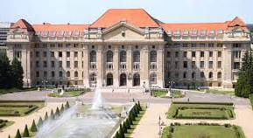
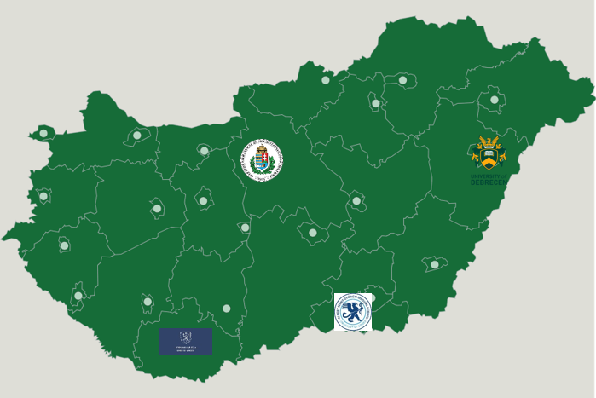
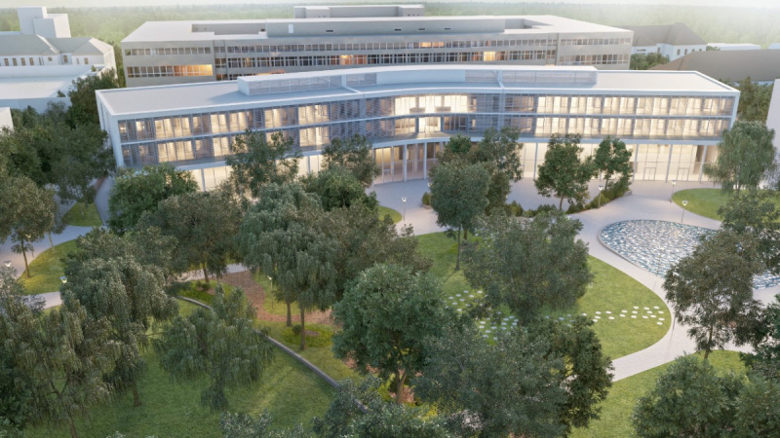
Medical schools of Hungary
Faculty of Medicine
Semmelweis University
Faculty of Medicine
University of Debrecen
Medical School
University of Pécs
Albert Szent-Györgyi Medical School
University of Szeged
Sources of images: Wikipedia, unideb.hu, mandiner.hu, szeged.ma, uscarfriendewestbrabant.nl

Slide 6
Preparation and the accreditation procedure, 2019–2022
Autumn 2019
Consultation with QA agency NVAO (Accreditation Organisation of the Netherlands and Flanders) about the WFME recognition process
Summer 2020
MAB pilot procedure for medical schools: accreditation materials based on the 2015 edition of the WFME BME standards
Winter 2020
New edition of the WFME BME standards are published on December 21, 2020
January 2021
Preliminary application form is completed and submitted to WFME
September 2021
Pilot site visit is conducted at MS UP
October 2021
Completed application form is submitted to WFME
November 2021
Site visit is conducted at FM UD and Board decision is made on the accreditation term of MS UP (in the presence of WFME Recognition Team)
December 2021
WFME Recognition Report is sent to MAB
January 2022
MAB submits its answers to the Recognition Report
March 2022
MAB obtains WFME Recognition Certificate and submits the filled-in feedback form required by WFME
Sources of images: student.uva.nl, unideb.hu, old.aok.pte.hu, freelogovectors.net, med.u-szeged.hu, wfme.org

Slide 7
Documents prepared during the accreditation process
Documents submitted to WFME
MAB Standards for Medical Education
Rules of Procedure for the Accreditation of Medical Education
Evaluation sheet for the Accreditation of Medical Education
Filled-in and signed WFME application form
External and international relationships of MAB
MAB Labour Regulations (excerpt)
MAB profit and loss statement 2016-2020
Self-assessment report of the MS UP
MAB accreditation report on the MS UP
Self-assessment report of the FM UD
Site-visit team report template
Site visit schedule of MS UP
Site-visit schedule of FM UD
Reminders of the preparatory meetings
Site-visit team preparatory materials
Documents uploaded to the MAB website
MAB Standards for Medical Education
Rules of Procedure for the Accreditation of Medical Education
Evaluation sheet for the Accreditation of Medical Education
Organisational Structure of MAB in English
Timeline of the Accreditation Procedure
Documents prepared for the site-visit team members
Introductory materials: MAB, programme and outcome requirements of medical education in Hungary
Self-assessment report of FM UD
Evaluation sheet prepared for site-visit team members
Site-visit team report template

Slide 8
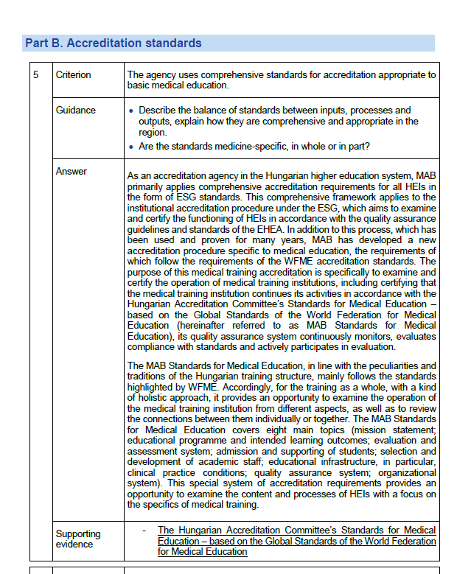
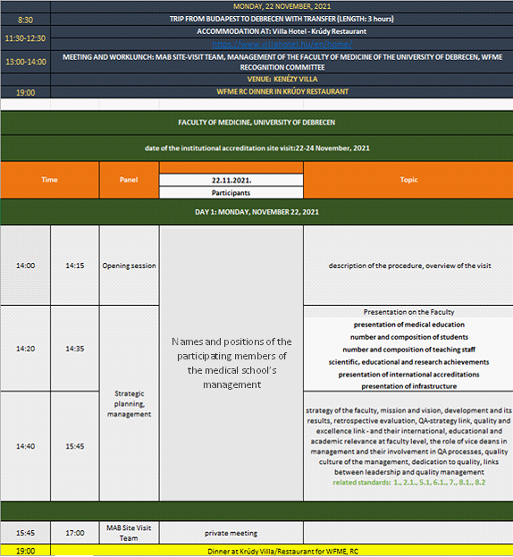

Slide 9
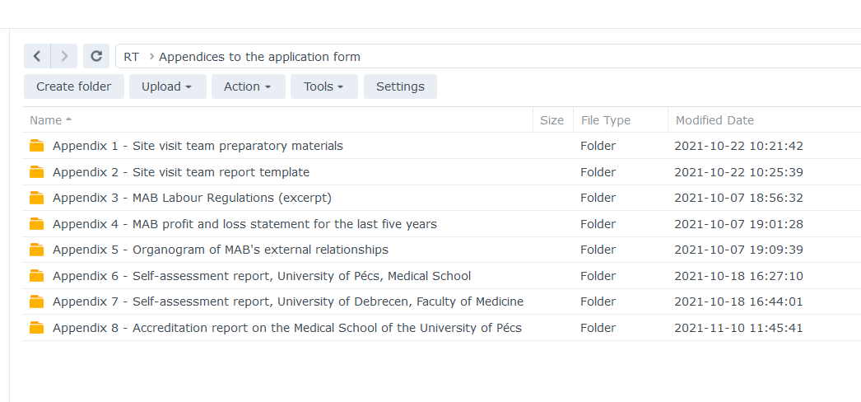
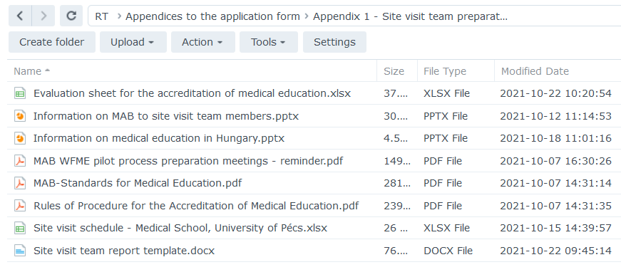
Folder shared with the WFME Recognition Team

Slide 10
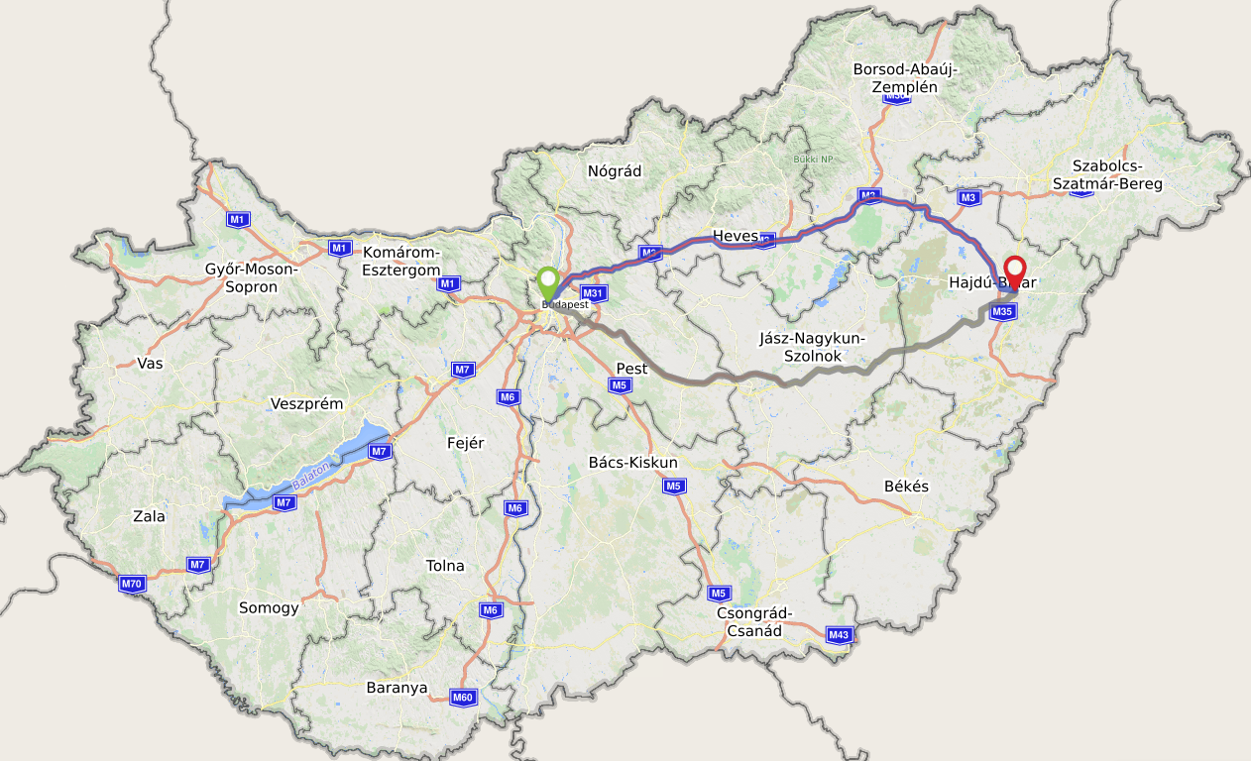
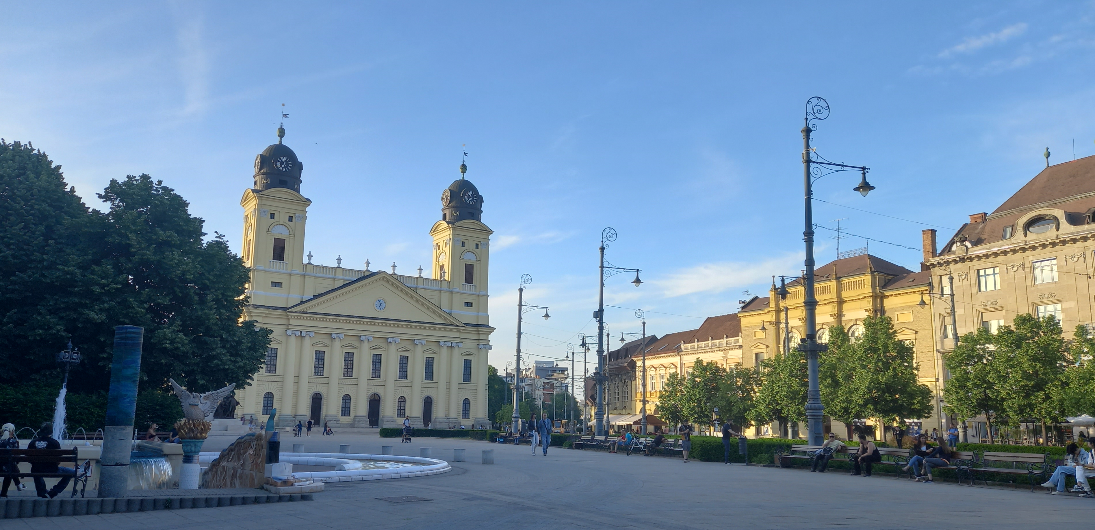
Site visit of the WFME Recognition Team
WFME recognition team: members from three countries

Slide 11
Conclusions drawn from the accreditation process
Sufficient time for translation
Close contact with the WFME administration
Accommodation
Administrative tasks with the medical school undergoing accreditation must be addressed well in time
More representatives from MAB in the WFME-MAB session

Slide 12
Thank you for your attention!

