Slide 1
Ensuring the quality of digital HE (in Hungary)
– a QA agency’s perspective –
Dr. Péter Levente Lakatos
Deputy director
Hungarian Accreditation Committee (MAB)

Slide 2



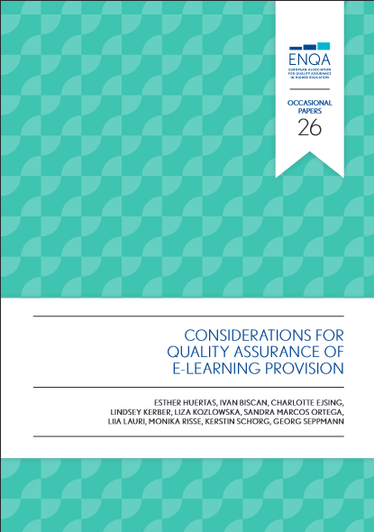
„…including growth of internationalisation, digital learning and new forms of delivery. The role of quality assurance is
crucial in supporting higher education systems and institutions in responding to these changes…”
„The ESG (…) provide guidance, covering the areas which are vital for
successful quality provision and learning environments in higher education.”

Slide 3
ESG 1.1: „HEIs should have a policy for QA that is made public and forms part of their strategic management. Internal stakeholders should develop and implement this policy (…), while involving external stakeholders.”
E-learning is part of the overall strategy (as well as QA policy)
HEI uses policy framework and governance structure when adopting new technologies to ensure the expected quality of e-learning provision
ESG 1.3: „HEIs should ensure that the programmes are delivered in a way that
encourages students to take an active role in creating the learning process, and that the
assessment of students reflects this approach. ”
Technical infrastructure is aligned with the teaching methodology
Staff needs to be trained to be able to provide contents, assignments etc.
Appropriate assessment methods
ESG 1.6: „HEIs should have (…) adequate and readily accessible learning resources and student support are provided.”
HEIs should analyze the learner profile of e-learning students
Access to library resources and labs
(included in MAB Standards, see at IA Guide, II.6. question 13.)

Slide 4

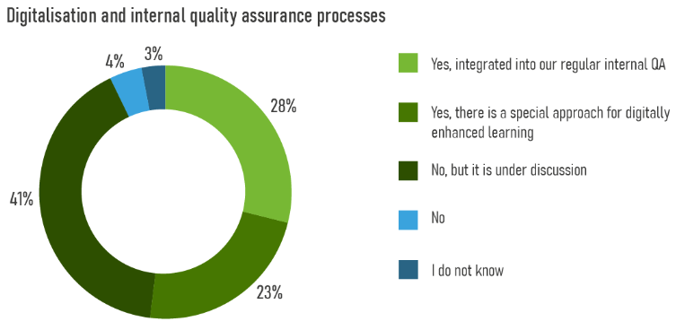
Documents, projects for reference
ENQA - Considerations for QA of E-learning Provision
https://www.enqa.eu/publications/considerations-for-qa-of-e-learning-provision/
Tesla Project (Enhancing Trust in E-Assessment)
https://tesla-project-eu.azurewebsites.net/work-package/wp4/
EUA - DIGI-HE Survey report
https://eua.eu/downloads/publications/digihe%20new%20version.pdf

Slide 5

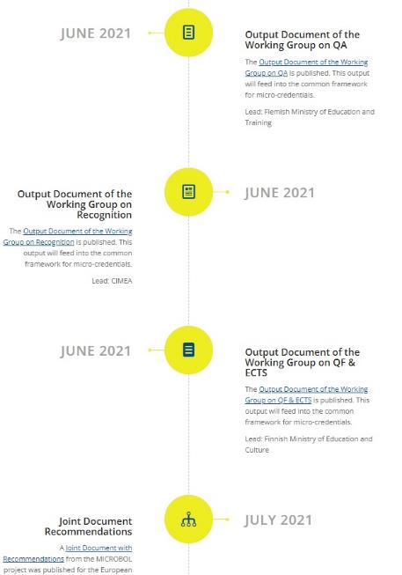

MAB’s role:
Dissemination
  Workshop
  Publishing studies in HAR
Review of procedures
  Institutional accreditation
  Ex post evaluation
Working Groups on:
QF & ECTS
Recognition
QA
OECD (2021) "Quality and value of micro-credentials in higher education: Preparing for the future", OECD Education Policy Perspectives https://doi.org/10.1787/9c4ad26d-en

Slide 6

Importance:
50 % - of adult learning happens through non-formal education
9 % - of 25–64 year olds participate in some form of (mostly tertiary) formal education
(Eurostat, 2020)
„The future of HE will be (mostly) digital or not at all”

Slide 7
Thank you for your attention!

